Slide 1


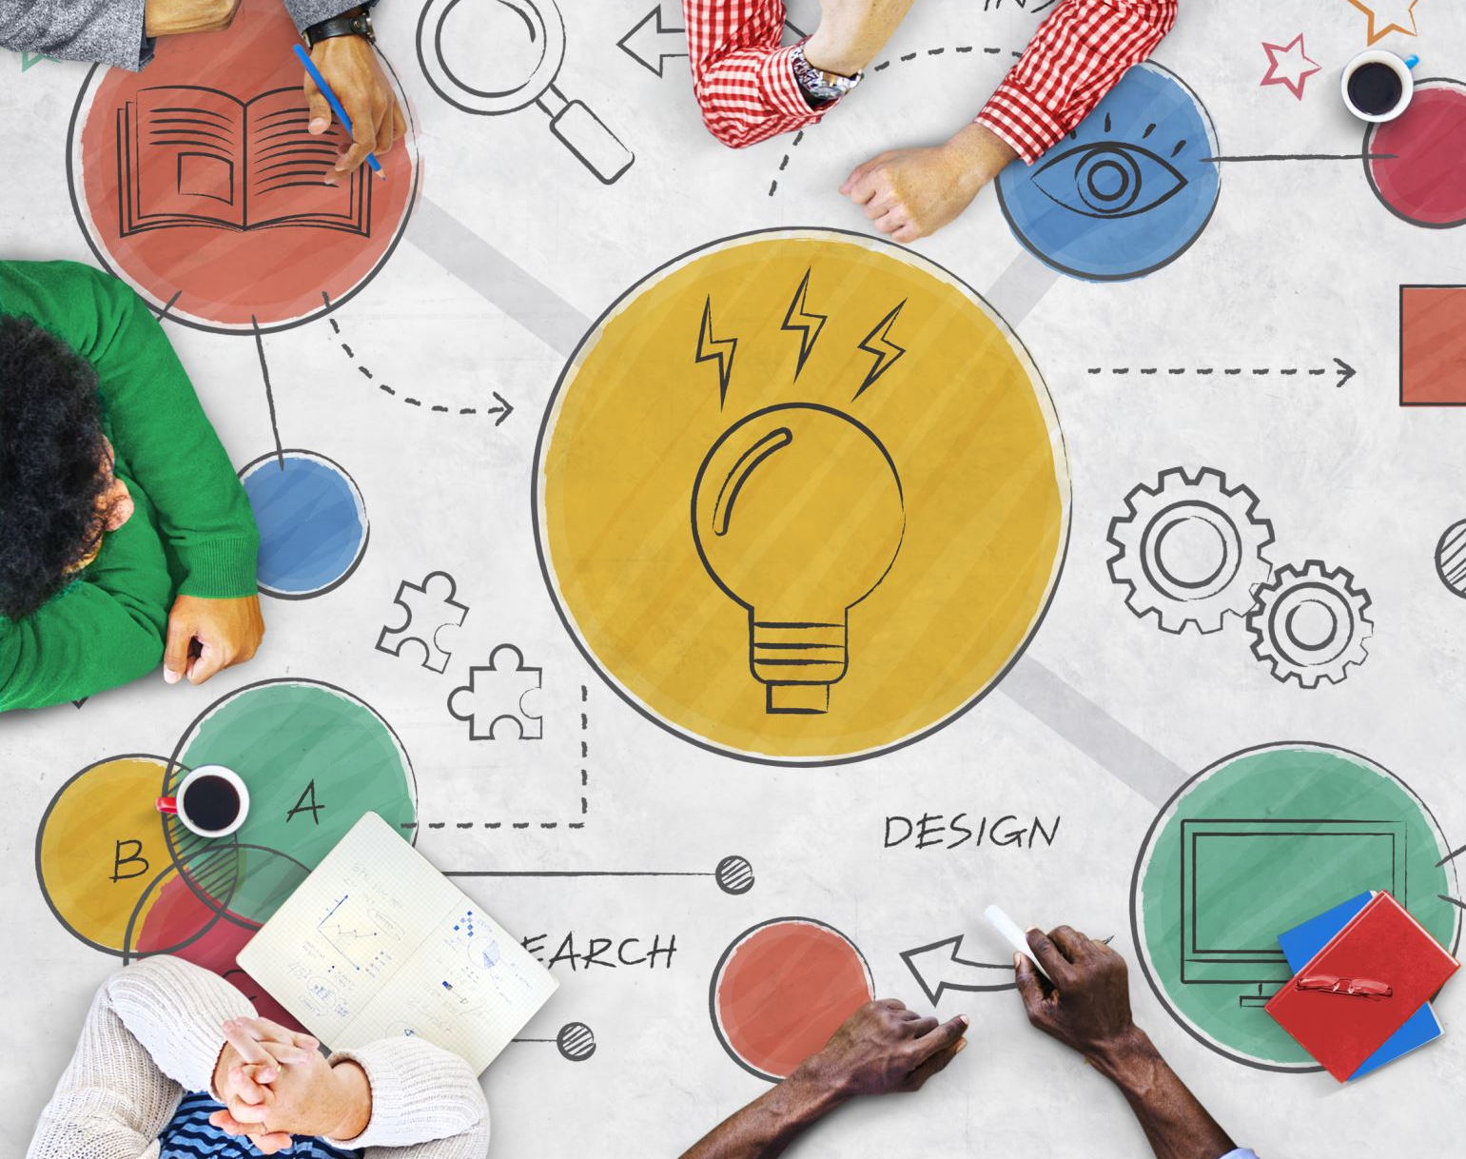
A curriculum for well-being.
Matt Burns – Headlands School

Slide 2

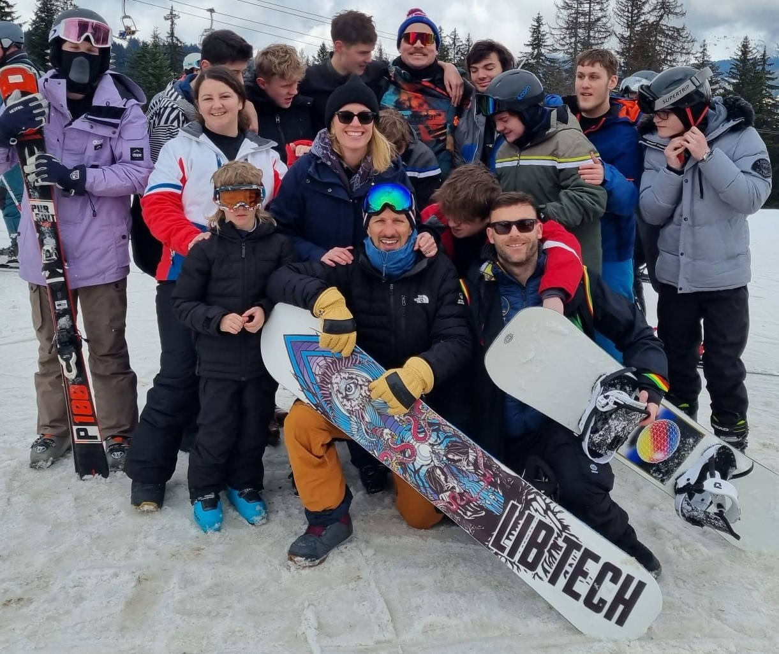
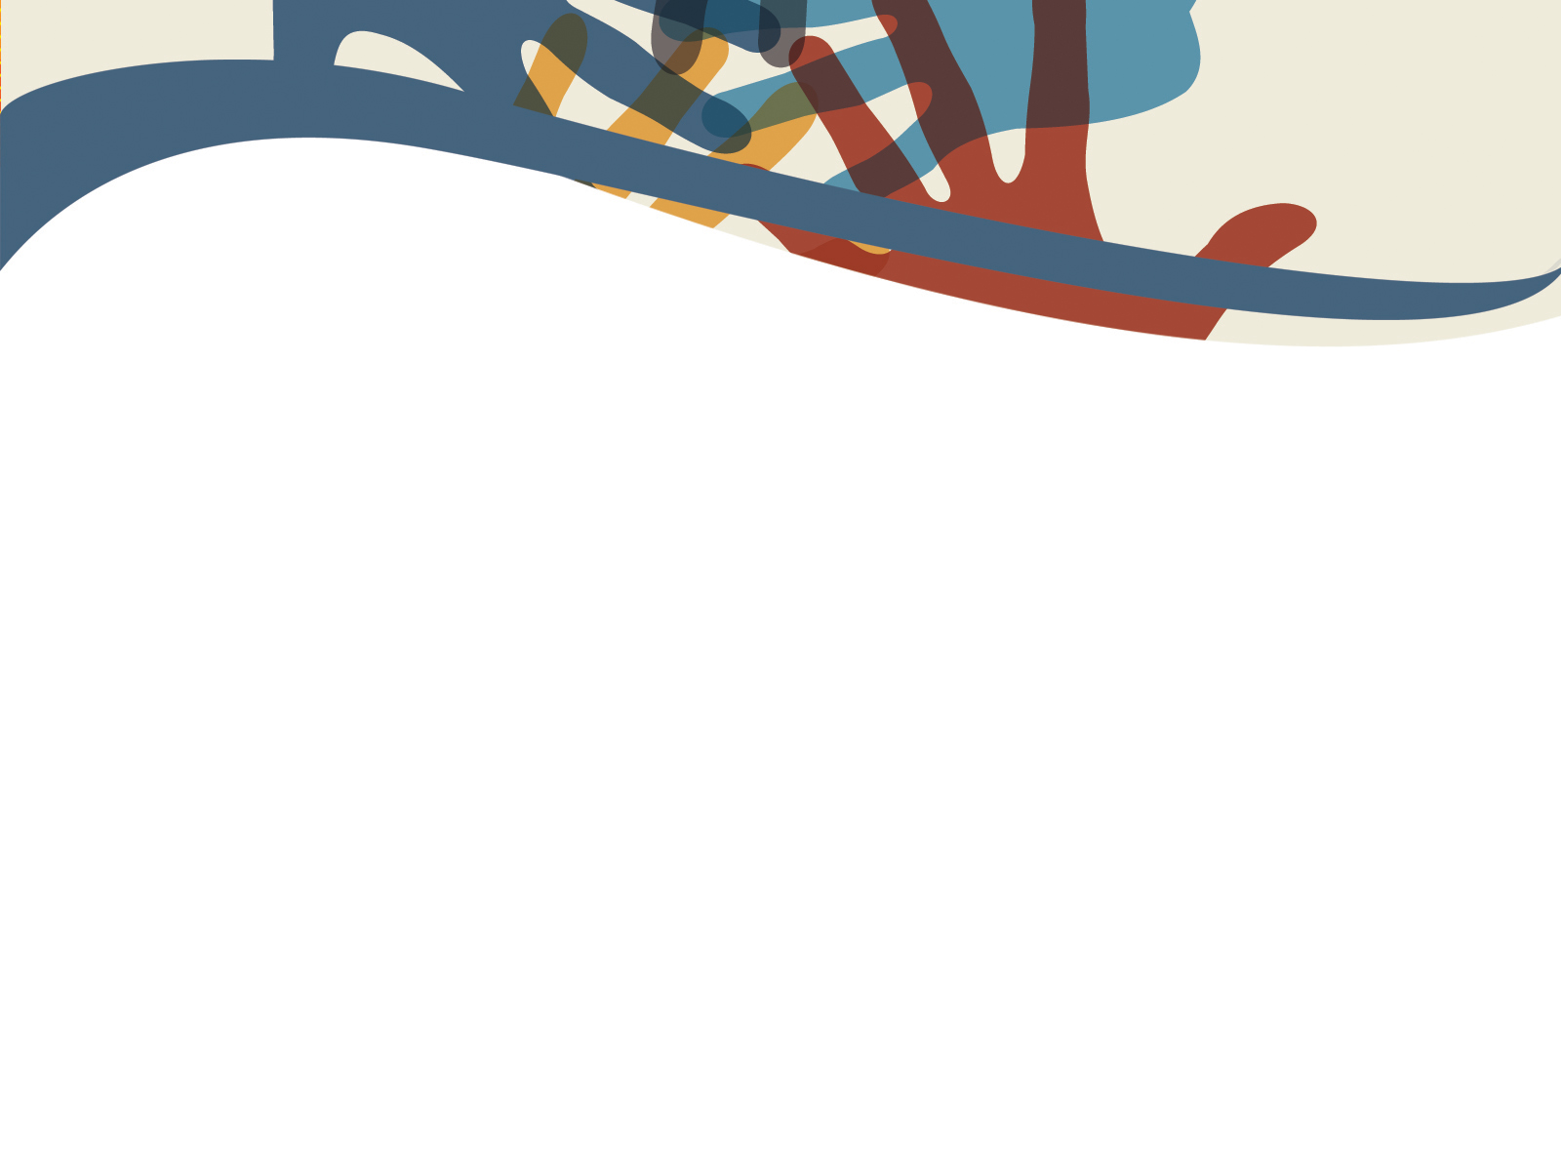
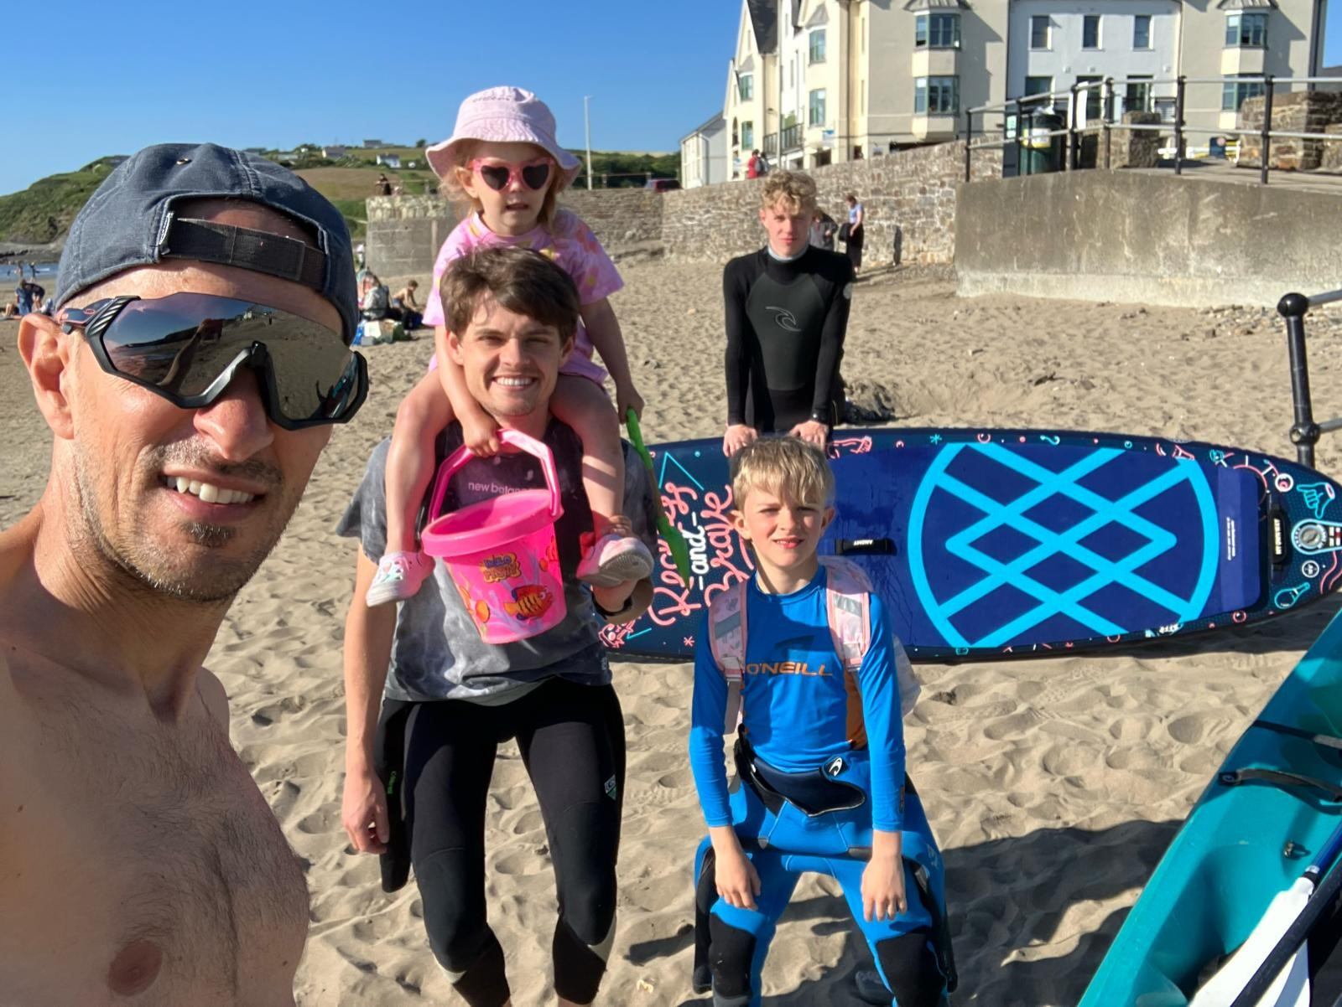
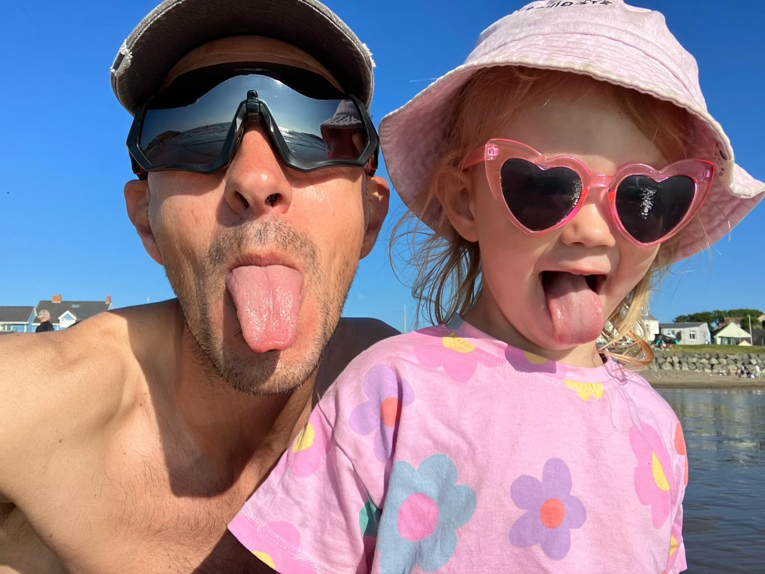
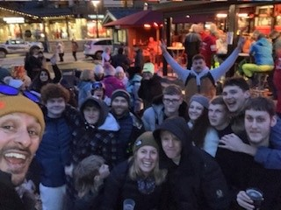
Shwmae!
“Our future, and the well-being of all our children rests with the kind of relationships we build today.”
Chief Dr. Robert Joseph
Notes:
I’m Matt Burns and I’m the principal at Headlands School which is wonderful community of students, educators and care staff (and here are some pics of a group we took to the French Alps last week), I’m a dad to three 3 boys in different phases of the school system, and this is my grandaughter, who will be started her journey in school from Sept. At Headlands we believe that our health and wellbeing is embedded in our relationships and this presentation is about our journey in creating a school based on the quality of our relationships.
I’ve worked as a teacher, deputy headteacher and have been the principal at Headlands for the last 18 years. I also work at an operational director level in our charity in Wales, and I currently lead a group of 5 residential care homes at Headlands. So, I’ve experienced working at nearly all levels of the system.
The majority of my leadership roles have been spent working with children in education and care who have experienced adversity, trauma, and exclusion. For many this has led to difficult home lives, isolation from their local communities, and exclusion from schools. Working in this field has meant a large part of my work has been dedicated to developing organisational practice related to improving wellbeing. So as a leader, educator, and parent I have skin in the game in relation to how schools best promote well-being.

Slide 3


“Wellbeing has a ‘holographic’ quality; different meanings are being projected by different agents and what is apparently meant by the use of the term depends on where you stand. There are few fixed points or commonalities beyond ‘it’s a good thing’. Effectively, wellbeing acts like a cultural mirage: it looks like a solid construct, but when we approach it, it fragments or disappears.”
Euraut and Whiting (2008)
Notes:
In research looking at the meaning of wellbeing, Euraut and Whiting described it as ‘holographic’, suggesting it’s an elusive and changing idea. This research and other critical perspectives, prompted us to think more carefully about what wellbeing meant for us in our school community. It prompted critical reflection on our wellbeing curriculum which had been in place since 2010. Ultimately, we felt we had ended up with an incongruent and adhoc collection of interventions which felt distinctly separate and disconnected from our curriculum. While we felt that this work was well intentioned and designed explicitly to address the complex trauma histories experienced by our students, we felt it was problematic because it focused on identifying and fixing individual deficits in social and emotional skills, and/or developing anger management strategies.

Slide 4
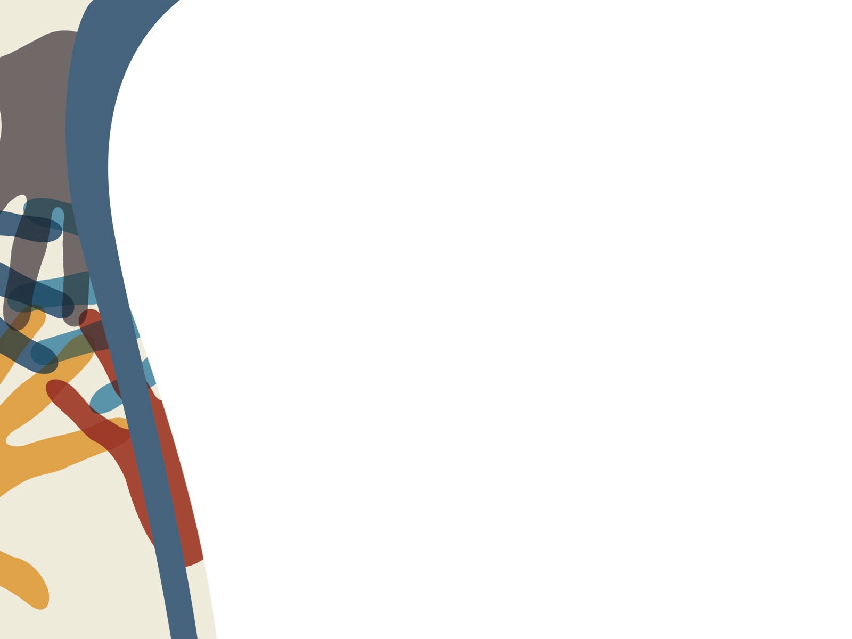
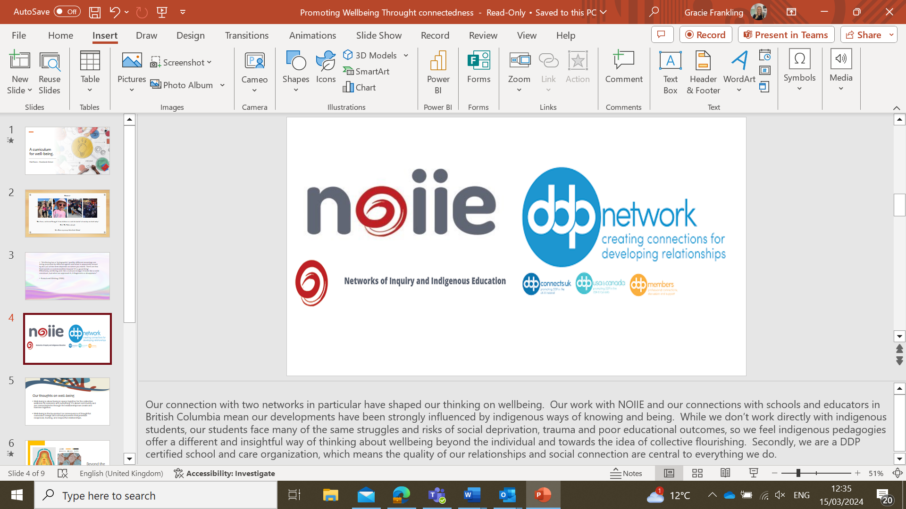
Notes:
Our connection with two networks has shaped our current thinking on wellbeing. Firstly, our work with the Network of inquiry and indigenous education (NOIIE) and our connections with schools and educators in British Columbia (a world leading education system) mean our developments have been strongly influenced by indigenous ways of knowing and being. While we don’t work directly with indigenous students, our students face many of the same struggles and risks of social deprivation, trauma and poor educational outcomes, so we feel indigenous pedagogies offer a different and insightful way of thinking about wellbeing beyond the individual and towards the idea of collective flourishing. Secondly, we are a DDP certified school and care organization, which means the quality of our relationships and social connections are central to everything we do. DDP is dyadic developmental practice, which is a therapeutic model devised by Dan Hughes and is designed to support the development of healthy trusting relationships, particularly for children who have experience disruptions in their early life. You may have come across the concept of PACE which is part of this approach.

Slide 5
Our thoughts on well-being
Well-being is about being in space together for the collective wellness for everyone and everything. It’s about community and our connectedness through the relationships we create and harness together.
Well-being is the by-product or consequence of thoughtful curriculum design and school processes that prioritize reciprocal, trusting, and respectful relationships.
Notes:
Our learning about indigenous ways of understanding and relational-based approaches has led us to a new understanding, that wellbeing is the experience you have, when you have a positive connection with yourself, with your community and your environment. We don’t think wellbeing can be taught or caught, therefore, wellbeing cannot be a separate element of our school curriculum, but is the consequence of it. We also believe being well cannot be the sole responsibility of individuals, but is a collective responsibility. This perspective led to the challenging work of identifying and displacing parts of our curriculum and work which created disconnection. And we continue to work towards ensuring our curriculum, school organization and pedagogies promote connections and collaboration. This work is done through inquiry and has included things like staff and students eating together, creating opportunities to learn together, changing our assessment processes and the way we write about students. – An important part of this work has been increasing participatory practices, and developing our relationships with families and our local community. It’s a ground up approach.

Slide 6
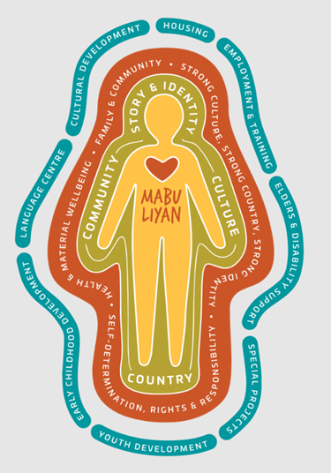
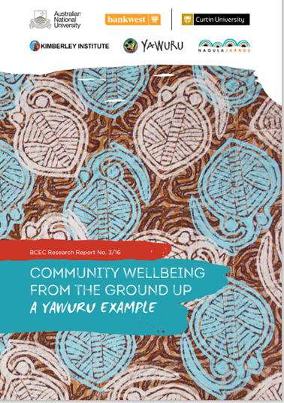
Beyond the individual
The Yawuru wellbeing term – Mabu Liyan
Notes:
An example of how indigenous ways have influenced our thinking can be seen in the term Mabu Liyan, which is a wellbeing term used by the The Yawuru people of West Kimberly in Australia. It represents the idea of collective flourishing or relationships beyond the individual. Indigenous understandings of wellbeing differ from more individualistic ideas in traditional western biomedical models, which we like because it further supports the importance of connections and community. It reflects the idea that, ‘I can’t be well if we are not well’ – that we live as interdependent beings connected to community and place. We also feel it resonates with our Welsh term Cynefin, which refers to the sense of belonging and connection we have with our people and surroundings.

Slide 7
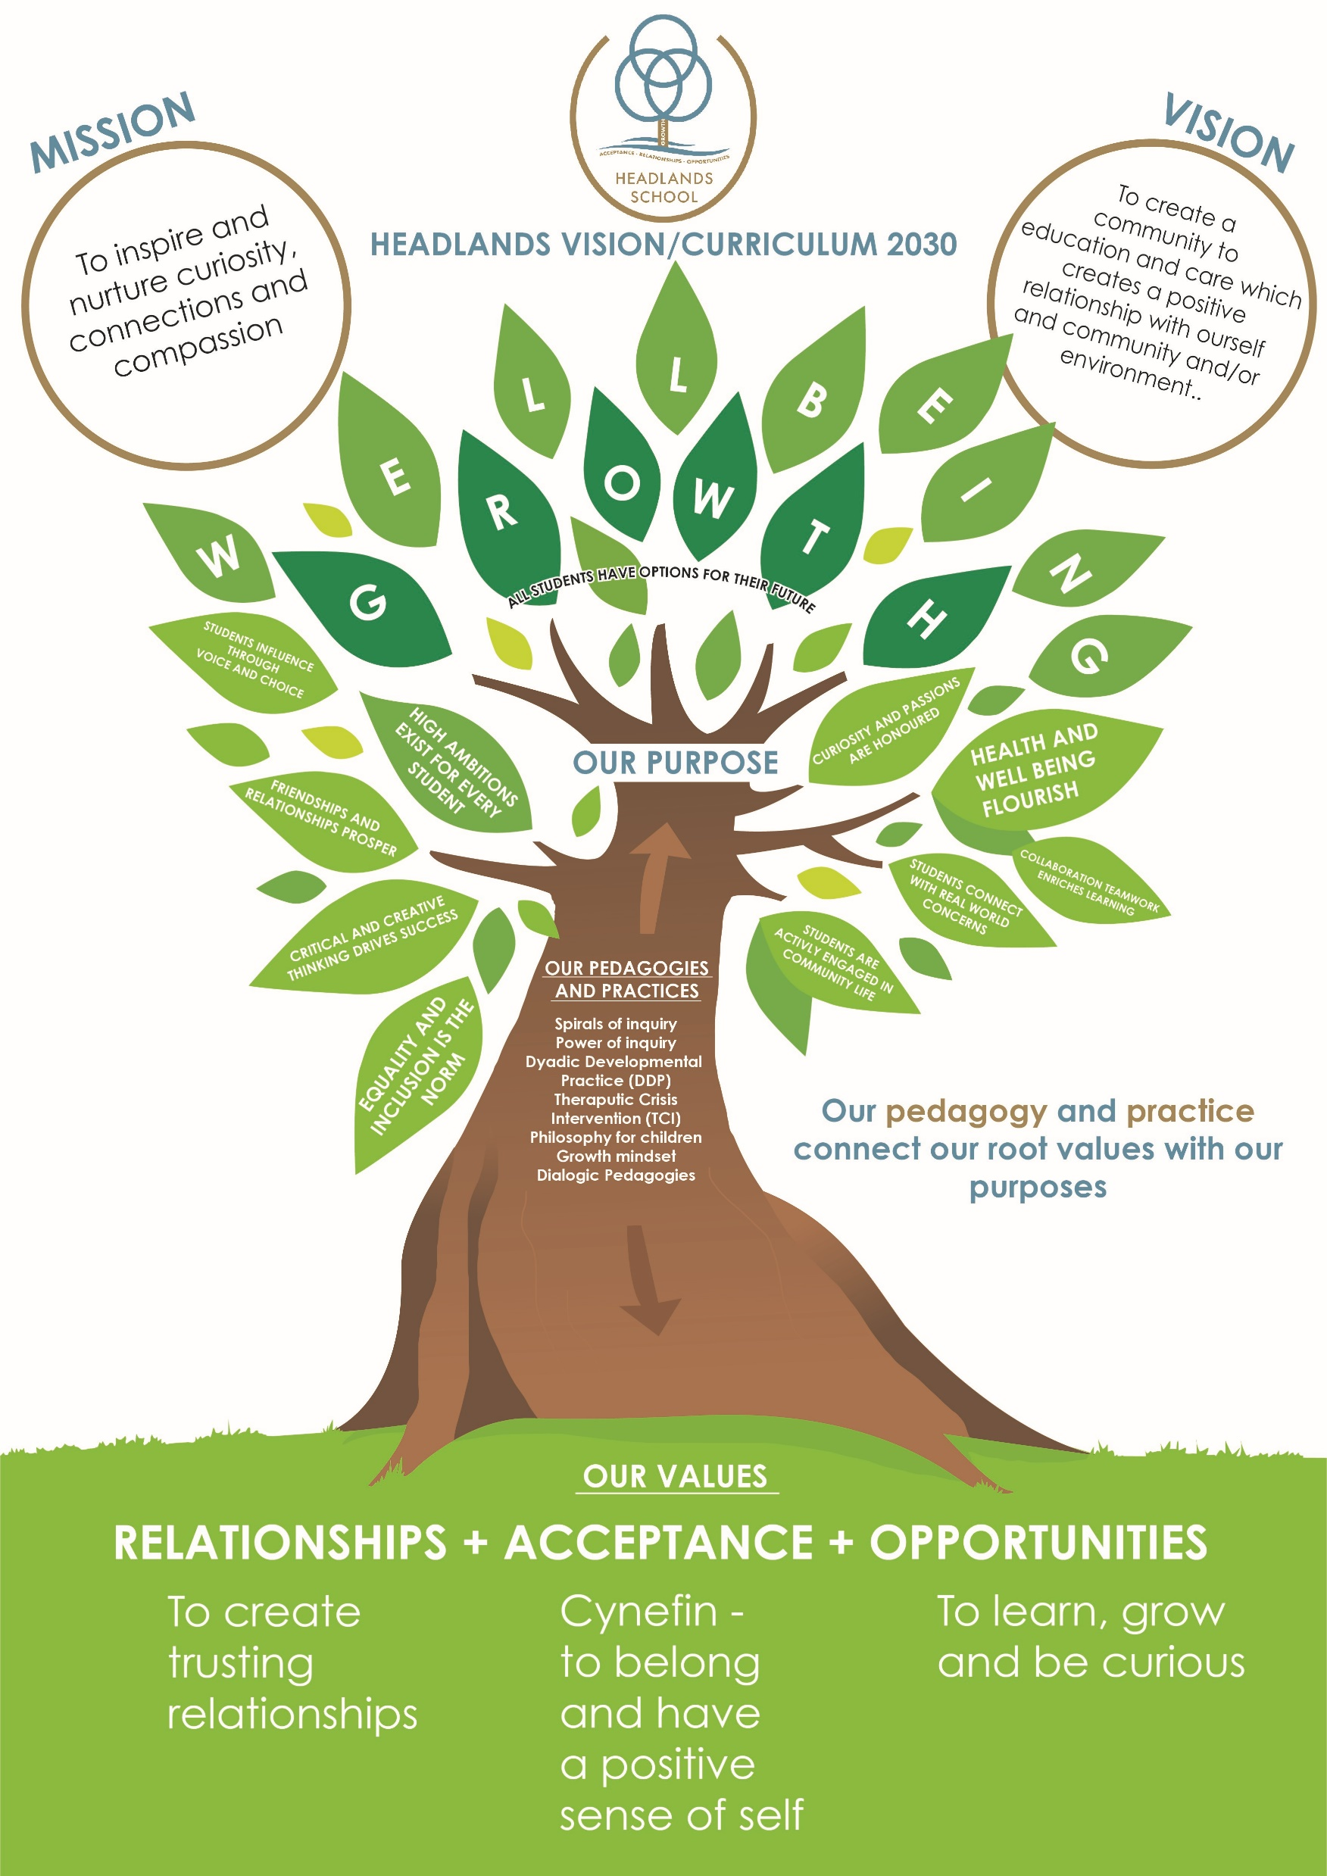
Our Curriculum
Notes:
So we don’t have a wellbeing curriculum anymore, we have a curriculum in which we are constantly striving to promote connections and relationships. Our visual outlines the connections between our values, core practices, and purpose which result in a sense of growth, wellbeing and collective flourishing. In this model wellbeing is not a secondary consideration but is the consequence of this approach.

Slide 8

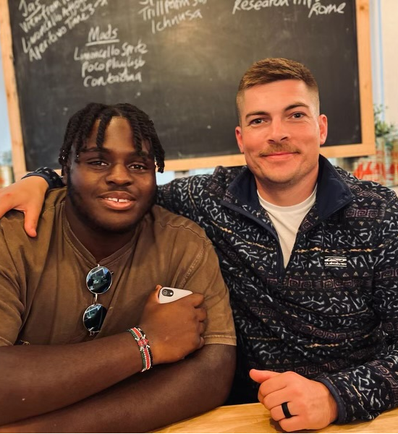
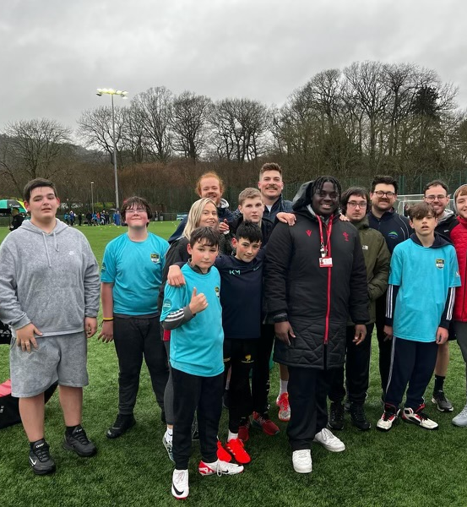
How do we know?
Can students name two adults who believe in them?
Can teachers and school staff name two team mates or leaders who believe they make a positive difference for students and the community?
Can parents/carers name a person at the school who they know and trust?
Notes:
These are the questions we ask to check on the impact of our work. They are simple and focus on the quality of relationships, providing a valuable impetus for action, for example, if a child can’t name 2 adults in our school that believes in them, and takes care of them, we know we have important work to do. We also need to know whether our team members, parents and carers also have people in our school who believe and care for them. I wanted to share this lovely story of Tom and Alex. Alex had joined us after a number of exclusions from schools and was dealing with hard challenges. His wonderful mother had moved to Wales from Uganda and Alex is one of three boys. Tom’s belief in Alex as a student and his effort to make meaningful connections with his family remains pivotal in his success. Tom is one of Alex’s people who believes in him. Alex is now completing his apprenticeship with the WRU as a coach, working with kids in clubs and schools. Studnets at Headlands have what we call, a ‘lifetime membership’, so many call in for lunch and a catch up. Alex called in few weeks ago full of pride, and with a great story to tell. He had lunch with Tom and took great relish telling him he’d been back to a one of the schools he’d been excluded from, to teach the kids rugby. Alex said he was nervous returning there, and wondered if anyone would remember him. But his old teachers were so proud of him and his story and they welcomed him back with open arms, a powerful moment of reconnection.

Slide 9

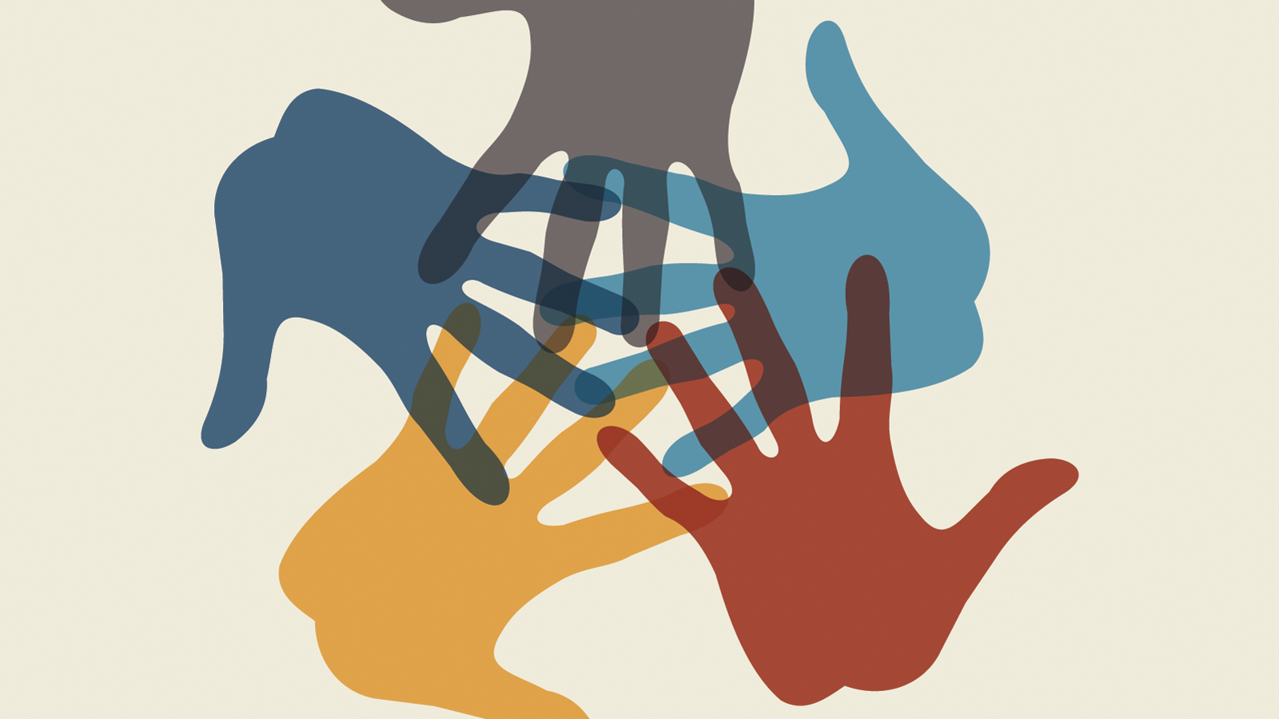

The power of relationships.
Notes:
To finish I wanted to share some thoughts from Brene Brown’s book ‘Braving the Wilderness’. In her book, Brown talks about the influence of neuro scientist John Cacioppo on her work. Cacioppo dedicated his career to understanding loneliness, belonging, and connection, and he argues that we don’t derive strength from rugged individualism, but from our collective spirit to communicate, plan and collaborate. Our neural, hormonal, and genetic makeup support interdependence over independence, Cacioppo says, for humans “to grow to adulthood as a social species, is not to become autonomous and solitary, it’s to become the one on whom others can depend. Whether we know it or not, our brain and biology have been shaped to favour this outcome”. It seems indigenous peoples have known this wisdom for a long time, it also suggests that schools organized around relational principles that foster connectedness will inevitably be places that foster health and wellbeing.

